Slide 1
Program Efficiency and Complexity
What will we be looking at:
What is an "efficient" program?
How can we measure efficiency?
The Big O Notation
Online resource
https://www.youtube.com/watch?v=D6xkbGLQesk

Slide 2
Why Measure Efficiency
Many ways to solve a problem.
  but which way (i.e. algorithm) is better

Slide 3
Complexity Analysis
"real time" execution depends on many factors like
  speed of computer
  programming language
  quality of compiler
In order to allow a
reasonable comparison
between
algorithms, a way
of measuring time
complexity is
required, that is
independent of all
such factors

Slide 4
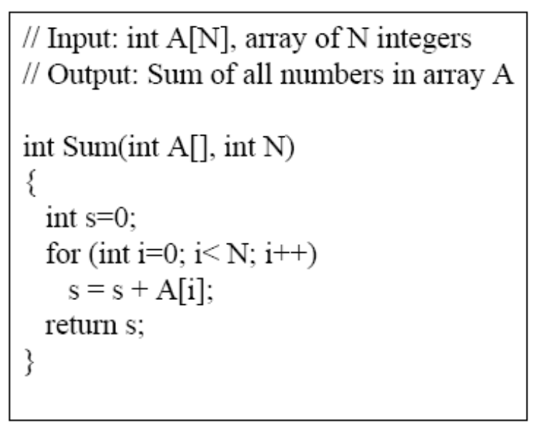
How do we Analyze an Algorithm?
A simple Example : Sum Method (function)
How should we analyze this?

Slide 5
Analysis of Sum Method
Efficiency of an algorithm is a function of the number of elements to be processed.
Lets get back to our Sum method:
  Count how many steps are used for an input of that size:
    A step is an elementary operation such as +, <, =, A[i]

Slide 6
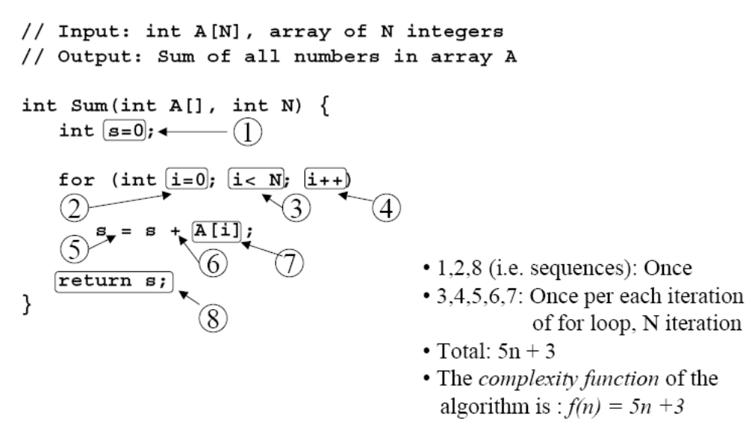
Analysis of Sum Method (3)

Slide 7
How 5n+3 Grows
Estimated running time for different values of n:
n = 10 => 53 steps
n = 100 => 503 steps
n = 1,000 => 5003 steps
n = 1,000,000 => 5,000,003 steps
As n grows, the number of steps grows in linear proportion to n for this Sum function.
This makes sense since f(n) = 5n+3 is a linear function in n.

Slide 8
Big Picture
What term in the previous complexity function dominates?
What about the 5 in 5n+3? What about the +3?
As n gets large, the +3 becomes insignificant
The 5 is inaccurate as different operations require varying amounts of time
What is fundamental is that the time is linear in n.
As n gets large, ignore all lower order terms and concentrate on the highest order term only:
i.e.
  Drop lower order terms such as +3
  Drop the constant coefficient of the highest order term.

Slide 9
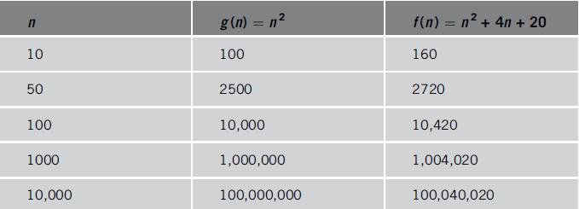
Relevance of Dominant Term
f(n) = n² + 4n + 20
As n becomes larger and larger
  Term 4n + 20 in f(n) becomes insignificant
  Term n² becomes dominant term
TABLE 1-4 Growth rate of n² and n² + 4n + 20n

Slide 10
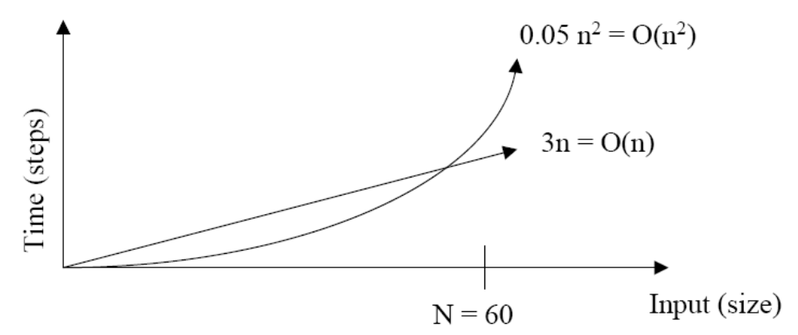
BigO notation
Ignores lots of (machine dependent) details, concentrates on the bigger picture.
Why is this useful?
  As inputs get larger, any algorithm of a smaller order will be more efficient than an algorithm of a larger order

Slide 11
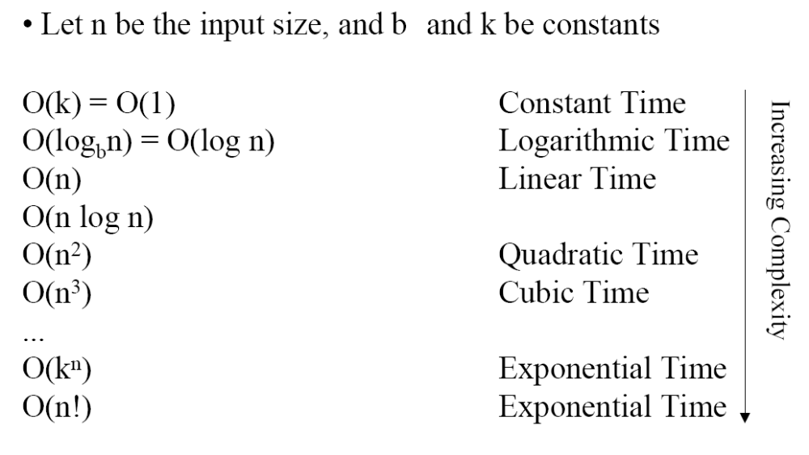
Common Orders of Growth

Slide 12
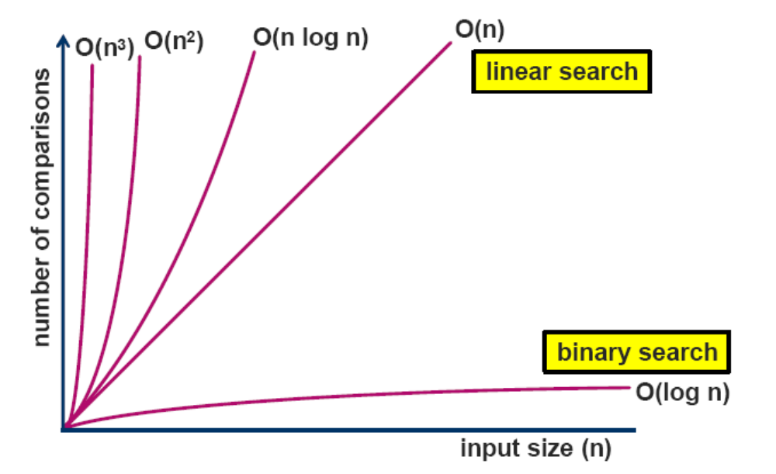
Complexity Classes
Time (steps)

Slide 13
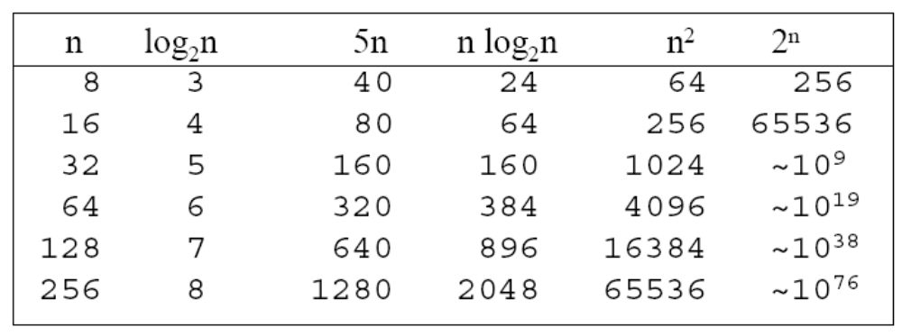
Comparing Complexity
What happens if we double the input size n?

Slide 14
Constant Time Statements
Simplest case: O(1) time statements
For example
  Assignment statements of simple data types
int x = y;
  Arithmetic operations:
x = 5 * y + 4 - z;
  Array referencing:
A[j] = 5;
  Most conditional tests:
if (x < 12) ...

Slide 15
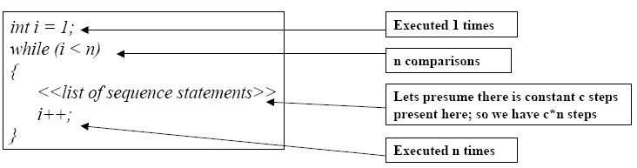
Analyzing Loops – Linear Loops
Example (have a look at this code segment):
Efficiency is proportional to the number of iterations.
Efficiency time function is :
f(n) = 1 + (n-1) + c*(n-1) +( n-1)
= (c+2)*(n-1) + 1
= (c+2)n – (c+2) +1
Asymptotically, efficiency is : O(n)

Slide 16
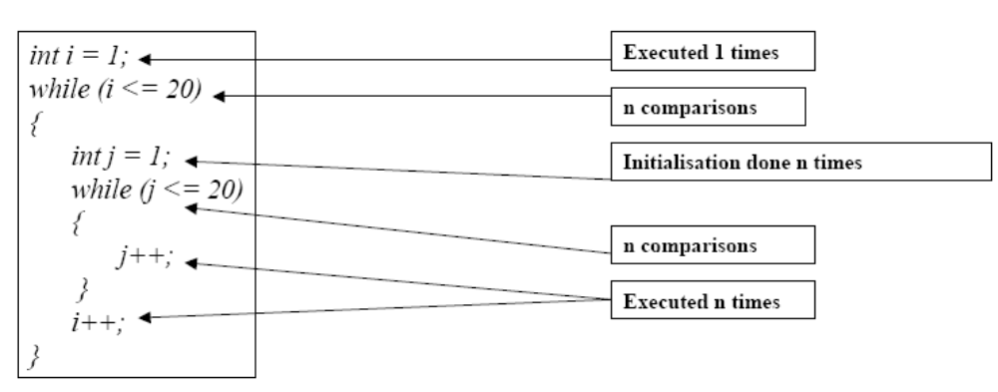
Analyzing Loops – Nested Loops
n )
n )

Slide 17
Analyzing Loops – Nested Loops (2)
Our time complexity function for our bit of code is then :
f(n) = 1+ n + n + (n² + n²) + n
inner loop
= 1 + 3n + 2n²
Asymptotically, efficiency is: O(n²)

Slide 18
Analyzing Loops – Nested Loops (3)
What if the number of iterations of one loop depends on the counter of the other?
int j,k;
for (j=0; j < N; j++)
for (k=0; k < j; k++)
sum += k+j;
Solution :
Analyze inner and outer loop together:
  Number of iterations of the outer and inner loop together:
0 + 1 + 2 + ... + (n-1) = O(n²)

Slide 19
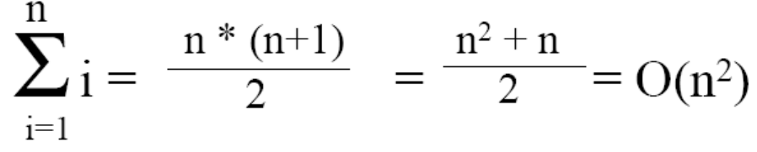
How Did We Get This Answer?
When doing Big-O analysis, we sometimes have to compute a series like: 1 + 2 + 3 + ... + (n-1) + n
i.e. Sum of first n numbers. What is the complexity of this?
Gauss figured out that the sum of the first n numbers is always:
If we had analyzed each loop separately in the previous code we would have worked out that the outer loop iterates n times and the inner loop iterates (n+1)/2 times so total number of iterations is n*(n+1)/2 which is Gauss’s equation

Slide 20
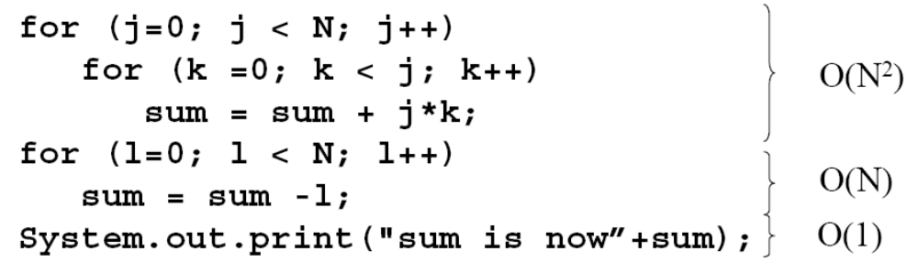
Sequence of Statements
For a sequence of statements, compute their complexity functions individually and add them up
Total cost is O(n²) + O(n) +O(1) = O(n²)

Slide 21
ANALYSIS

Slide 22
Array Analysis
Function | Analysis
Addatfront(value) | O(n)
Addatend(value) | O(1)
Insert(value, position) | O(n)
valueat(position) | O(1)
Search(value) | O(n)
Delete(value@Position) | O(n)
Destructor | O(1)
PrintValues() | O(n)

Slide 23
Linked List Analysis
Function | Analysis
Addatfront(value) | O(1)
Addatend(value) | O(1) with tail pointer
Insert(value, position) | O(n)
valueat(position) | O(n)
Search(value) | O(n)
Delete(value@Position) | O(n)
Destructor | O(n)
PrintValues() | O(n)

Slide 24
Stack Analysis
Function | Array impl | Link List imp
Push | O(1) | O(1)
Pop | O(1) | O(1)
Top | O(1) | O(1)
Empty | O(1) | O(1)
Destructor | O(1) | O(n)
Size | O(1) | O(1)

Slide 25
Queue Analysis
Function | Array impl | Link List imp
Push | O(1) | O(1)
Pop | O(1) | O(1)
Front | O(1) | O(1)
Back | O(1) | O(1)
Empty | O(1) | O(1)
Destructor | O(1) | O(n)
Size | O(1) | O(1)

